Slide 1
Basics of Software Testing

Slide 2
Objectives
  At the end of this module, you will be able to:
  Describe Software Development Process Models
  Explain the Waterfall model, its usage, advantages and disadvantages
  Describe the V – Model, its usage, advantages and disadvantages
  Explain the Incremental model, its usage, advantages and disadvantages
  Describe the Iterative model, its usage, advantages and disadvantages
  Explain the Agile model, its usage, advantages and disadvantages

Slide 3
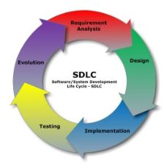
Introduction
  There are various Software Development Life Cycle(SDLC) models defined, designed and followed during the software development process. These models are also referred to as "Software Development Process Models". Each model follows a series of steps unique to its type, to ensure success in the process of software development. Every SDLC model has its own advantages and disadvantages. For success in the process of software development, selection of the model is based on the requirement and need of your project. STLC (Software Testing Life Cycle) aligns the test methodology with the SDLC method followed for a project.
  Here are a few commonly used methods for Software Development Life Cycle:
      Waterfall model
      V model
      Incremental
      Iterative
      Agile model

Slide 4
Testing Methodology aligned with SDLC
Testing is an integral part of software development. Poor testing methodologies lead to unstable products and unpredictable development times. It is essential to have a testing plan in place to ensure that the product delivered is robust, stable and delivered in a predictable timeline.
Standard development methodologies describe a set of general testing mechanisms that must be incorporated in the development lifecycle. These mechanisms start testing from very small piece by piece to testing the entire application functionality in the end.
  1) Unit Tests
  Unit tests focus on very small units of functionality. They cover the interaction of the code with memory only, and do not cover any interaction with network, database or file systems.
  2) Integration Tests
  Integration Tests provide a mechanism to test the interoperation of smaller units. Integration tests involve testing the modules that access the network, databases and file systems. Unit A may not be giving data properly to the Unit B and these issues come up in the integration tests.
  3) Functional Tests
  After the integration tests are performed, higher level tests are used. Functional tests check for the correctness of the output with respect to the input defined in the specification.
  4) Smoke Tests
  Smoke Tests analogy comes from the electronics where a mistake means that the circuit board gives out smoke. After functional tests are done, a simple test is done from the start, typically after a fresh installation and newer input values.
  5) Regression Tests
  Whenever complex bugs are patched in a system, that affect the core areas of the system, regression tests are used to re test all the modules of the system.
  6) Acceptance Tests
  These form the final level of the test plan. Every feature is checked from the user’s perspective by the testing team and the feature is marked as accepted or rejected. These tests test the application from the end user’s perspective like detecting crashes after going through a certain flow.

Slide 5
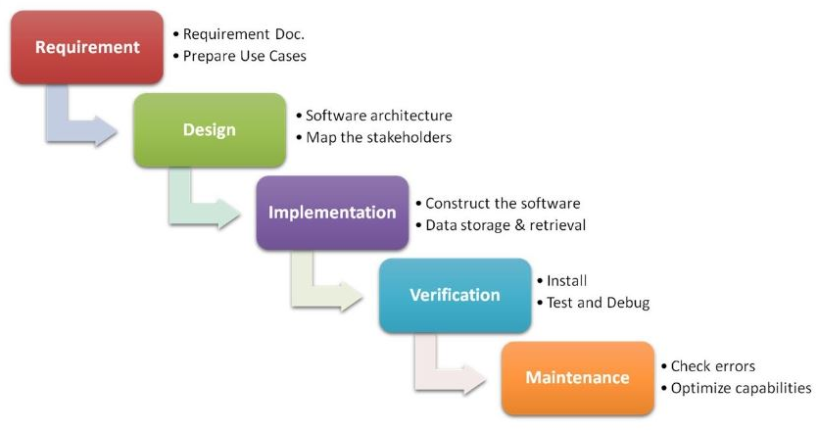
Waterfall Model
  The Waterfall Model was the first Process Model to be introduced. It is also referred to as a linear-sequential life cycle model. It is very simple to understand and use. In a waterfall model, each phase must be “completed” before the next phase can begin. This type of model is used for the project that is small and has no uncertain requirements. At the end of each phase, a review takes place to determine if the project is on the right path and whether or not to continue or discard the project. In this model, the testing starts only after the development is complete. In the waterfall model, phases do not overlap.

Slide 6
When to use Waterfall Model?
  Every software developed is different and requires a suitable SDLC approach to be followed based on the internal and external factors. Some situations where the use of Waterfall model is most appropriate are when:
    Requirements are very well documented, clear and fixed
    Product\application definition is stable
    Technology is understood and is not dynamic
    There are no ambiguous requirements
    Ample resources with required expertise are available to support the product
    The project is short

Slide 7
Advantages of Waterfall Model
  Advantages of waterfall model:
    Simple and easy to understand and use
    Easy to manage due to the rigidity of the model . Each phase has specific deliverables and a review process
    Phases are processed and completed one at a time
    Works well for smaller projects where requirements are very well understood
    Clearly defined stages
    Well understood milestones
    Easy to arrange tasks
    Process and results are well documented

Slide 8
Disadvantages of Waterfall Model
  Disadvantages of waterfall model:
    No working software is produced until late during the life cycle
    High risk and uncertainty
    Not a good model for complex and object-oriented projects
    Poor model for long and ongoing projects
    Not suitable for the projects where requirements are at a moderate to high risk of changing; so risk and uncertainty is high with this process model
    Difficult to measure progress within stages
    Cannot accommodate changing requirements
    Adjusting scope during the life cycle can end a project
    Integration is done as a "big-bang”, at the very end, that doesn't allow identifying any technological or business bottleneck or challenges early

Slide 9
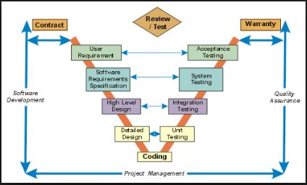
V-Model
  V- model means Verification and Validation model. Just like the waterfall model, the V-Shaped life cycle is a sequential path of execution of processes. Each phase must be completed before the next phase begins. Testing of the product is planned in parallel with a corresponding phase of development. V - Model is an extension of the waterfall model and is based on association of a testing phase for each corresponding development stage. This means that for every single phase in the development cycle, there is a directly associated testing phase. This is a highly disciplined model and next phase starts only after completion of the previous phase.

Slide 10
Phases of V-model
  The various phases of the V-model are as follows:
  Requirements like BRS and SRS begin the life cycle model just like in the waterfall model. But, in this model, before starting development, a system test plan is created. The test plan focuses on meeting the functionality specified in the requirements gathering phase.
  The high-level design (HLD) phase focuses on system architecture and design. It provides overview of the solution, platform, system, product and service/process. An integration test plan is created in this phase as well, in order to test the pieces of the software systems’ ability to work together.
  The low-level design (LLD) phase is where the actual software components are designed. It defines the actual logic for every component of the system. Class diagram with all the methods and relation between classes comes under LLD. Component tests are created in this phase as well.
  The implementation phase is, again, where all coding takes place. Once coding is complete, the path of execution continues up the right side of the V model.
  Coding: This is at the bottom of the V-Shape model. Module design is converted into code by developers.

Slide 11
When to use V Model?
  This model can be followed when:
    Requirements are well defined, clearly documented and fixed
    Product definition is stable
    Technology is not dynamic and is well understood by the project team
    There are no ambiguous or undefined requirements
    The project is short

Slide 12
Advantages & Disadvantages of V-Model
  Advantages of V-model:
    Highly disciplined model and phases are completed one at a time
    Works well for smaller projects where requirements are very well understood
    Simple and easy to understand and use
    Easy to manage due to the rigidity of the model; each phase has specific deliverables and a review process
  Disadvantages of V-model:
    High risk and uncertainty
    Not a good model for complex and object-oriented projects
    Poor model for long and ongoing projects
    Not suitable for the projects where requirements are at a moderate to high risk of changing
    Once an application is in the testing stage, it is difficult to go back and change a functionality
    No working software is produced until late during the life cycle

Slide 13
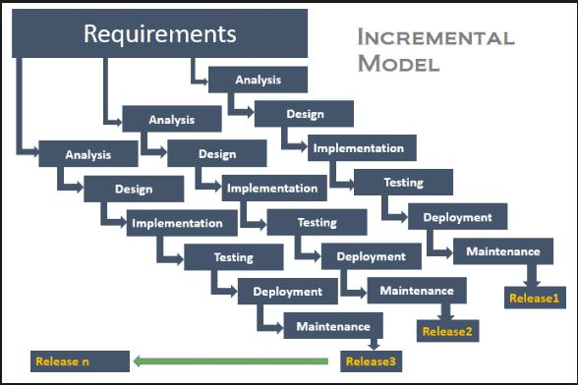
Incremental model
  In the incremental model, the entire requirement is divided into various builds. Multiple development cycles take place here, making the life cycle a “multi-waterfall” cycle. Cycles are divided into smaller, easily managed modules. Each module passes through the requirements, design, implementation and testing phases. A working version of the software is produced during the first module. So, you have a working software early during the software life cycle. Each subsequent release of the module adds functions to the previous release. The process continues till the complete system is ready

Slide 14
When to use Incremental Model?
  This model can be followed when:
  There is a need to get a product to the market early
  Initial requirements are very clear and completely understood
  Major requirements must be defined; however, some details can evolve with time
  Less resources are available

Slide 15
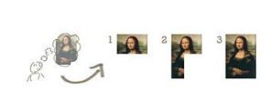
Example – Incremental Model
In the diagram below, when we work incrementally, we are adding piece by piece but expect that each piece is fully finished. Thus, we keep adding the pieces until it is complete. As in the image, a person has thought of the application. Then, he starts building it and in the first iteration, the first module of the application or product is ready and can be demoed to the customers. Likewise, in the second iteration, the other module is ready and integrated with the first module. Similarly, in the third iteration, the entire product is ready and integrated. Hence, the product gets ready step by step.

Slide 16
Advantages & Disadvantages of Incremental Model
  Advantages of Incremental model:
    Generates working software quickly and early during the software life cycle
    Flexible – less costly to change scope and requirements
    Easier to test and debug during a smaller iteration
    Easier to manage risk because the high risk pieces are identified and handled during its earlier iteration
    Each iteration is an easily managed milestone
    Easy to perform testing as each module is developed separately
  Disadvantages of Incremental model:
    Need full specification and requirements so that number of modules could be decided
    Each phase of an iteration is rigid, and phases do not overlap
    Total cost is higher than waterfall.

Slide 17
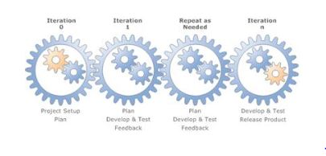
Iterative model
  An iterative life cycle model does not attempt to start with a full specification of requirements. Instead, development begins by specifying and implementing just part of the software, that can then be reviewed to identify further requirements. This process is then repeated, producing a new version of the software for each cycle of the model. The idea behind this method is to develop a system through repeated cycles (iterative) and in smaller portions at a time (incremental).

Slide 18
When to use Iterative Model?
  This model can be followed when:
    Requirements of the complete system are clearly defined and understood
    Major requirements must be defined; however, some functionalities or requested enhancements may evolve with time
    There is a time to the market constraint
    A new technology is being used and is being learnt by the development team while working on the project
    Resources with needed skillset are not available and are planned to be used on contract basis for specific iterations
    There are some high risk features and goals that may change in the future

Slide 19

Example – Iterative Model
In the diagram below, when we work iteratively, we create a rough product or product piece in one iteration, then review it and improve it in next iteration and so on until it is completed. As shown in the image below, in the first iteration, the entire painting is sketched roughly, in the second iteration, colors are filled and in the third iteration, finishing is done. Hence, in iterative model, the entire product is developed step by step.

Slide 20
Advantages of Iterative Model
  Advantages of Iterative model:
    Some working functionality can be developed quickly and early in the life cycle
    Results are obtained early and periodically
    Parallel development can be planned
    Progress can be measured
    Less costly to change the scope/requirements
    Testing and debugging during smaller iterations is easy
    Risks are identified and resolved during iteration; and each iteration is an easily managed milestone
    Easier to manage risks - High risk part is addressed first
    With every increment, an operational product is delivered
    Issues, challenges and risks identified from each increment can be utilised/applied to the next increment
    Risk analysis is better
    It supports changing requirements
    Initial Operating time is less
    Better suited for large and mission-critical projects
    During the life cycle, software is produced early that facilitates customer evaluation and feedback

Slide 21
Disadvantages of Iterative Model
Disadvantages of Iterative model:
    More resources may be required.
    Although cost of change is comparatively less, it is not suitable for changing requirements.
    More management attention is required.
    System architecture or design issues may arise because not all requirements are gathered in the beginning of the entire life cycle.
    Defining increments may require definition of the complete system.
    Not suitable for smaller projects.
    Management complexity is more.
    End of project may not be known which is a risk.
    Highly skilled resources are required for risk analysis.
    Projects progress is highly dependent upon the risk analysis phase.

Slide 22
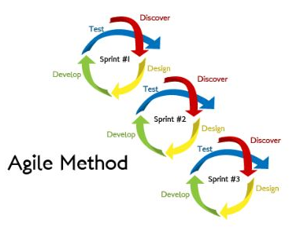
Agile Model
Agile SDLC model is a combination of iterative and incremental process models with focus on process adaptability and customer satisfaction by rapid delivery of a working software product.
Agile Methods break the product into small incremental builds. These builds are provided in iterations. Each iteration typically lasts from about one to three weeks. Every iteration involves cross functional teams working simultaneously on various areas like planning, requirements analysis, design, coding, unit testing, and acceptance testing.
At the end of the iteration, a working product is displayed to the customer and important stakeholders.

Slide 23
Agile Manifesto
The Agile Manifesto includes four core values:
    Individuals and interactions over Processes and tools
    Working software over Comprehensive documentation
    Customer collaboration over Contract negotiation
    Responding to change over Following a plan
The Agile Manifesto is based on twelve principles:
    Customer satisfaction by rapid delivery of useful software
    Welcome changing requirements, even late in development
    Working software is delivered frequently (weeks rather than months)
    Working software is the principal measure of progress
    Sustainable development, able to maintain a constant pace
    Close, daily cooperation between business people and developers
    Face-to-face conversation is the best form of communication (co-location)
    Projects are built around motivated individuals, who should be trusted
    Continuous attention to technical excellence and good design
    Simplicity—the art of maximizing the amount of work not done—is essential
    Self-organizing teams
    Regular adaptation to changing circumstances

Slide 24
Agile Testing Objectives
    Test as early and as often possible
    Continuously plan the testing effort with every sprint
    Adapt and Evolve with each delivery and test cycle
    Test enough and Prioritise
    Test most important features first
    Pair testing with development
    Constant development /testing interaction
    Jointly develop test cases
    Leading/guiding agile principle “Everyone test, Customer accepts”

Slide 25
When to use Agile Model?
  This model can be followed when:
    New changes must be implemented. The freedom agile gives to change is very important. New changes can be implemented at very little cost because of the frequency of new increments that are produced.
    To implement a new feature, the developers need to lose only the work of a few days, or even only hours, to roll back and implement it.
    Unlike the Waterfall Model, in the agile model, limited planning is required to get started with the project. Agile assumes that the end users’ needs are ever changing in a dynamic business and IT world. Changes can be discussed and features can be newly effected or removed based on feedback. This gives the customer the finished system they want or need.
    Both system developers and stakeholders alike, find that they also get more freedom of time and options than if the software was developed in a more rigid, sequential manner. Having options gives them the ability to leave important decisions until more or better data or even entire hosting programs are available; meaning the project can continue to move forward without fear of reaching a sudden standstill.

Slide 26
Agile – Terminologies
  Sprint - Often referred to as an Iteration, is a time-boxed and recurring period of time in which the working software is created. The most commonly used sprint durations are 2,4,6 week periods.
  Daily Scrum - Also known as 'Daily Stand-up‘, it is a daily communication and planning forum, in which Agile/Scrum teams come together to evaluate the health and progress of the iteration/sprint. Its focus is on discussing yesterday's completion, today's plan and any obstacles.
  Scrum of Scrums - Similar to Daily Scrum, it is a daily communication forum commonly used in larger projects utilizing multiple scrum teams. iceScrum is the free platform for your agile developments; it is designed for Scrum, the most popular agile method.
  User stories – They are simple, brief and concise statements, used to describe customer software requirements, from a particular user's perspective.
  Retrospective - In Agile project management, a retrospective meeting is held at the end of every iteration to discuss what really went well and what didn’t go well and any action items to carry over the next Sprint. Retrospective meetings are useful to identify the ways of continuous improvement of an Agile team.

Slide 27
Agile – Terminologies
  Product owner - Product owner is often referred to as 'Voice of customer' on an Agile project or the 'Product Manager' on a traditional project. Product owner is the person responsible for communicating the customer requirements.
  Scrum Master - Scrum Master is responsible for facilitating all Scrum meetings, removing team impediments, protecting teams from external distractions, keeping the team on-track to ensure that the team is best able to deliver against the sprint goals.
  Product Backlog – Agile projects typically employ a top level backlog, known as a product backlog or release backlog, and each Agile team working on a project typically creates a backlog for each development iteration, known as an iteration backlog or sprint backlog.
  Impediment - In scrum, impediment is any obstacle preventing a developer or team from completing work.

Slide 28
Advantages of Agile Model
  Advantages of Agile model:
    Is a very realistic approach to software development
    Promotes teamwork and cross training
    Functionality can be developed rapidly and demonstrated
    Resource requirements are minimum
    Suitable for fixed or changing requirements
    Delivers early partial working solutions
    Good model for environments that change steadily
    Minimal rules, documentation easily employed
    Enables concurrent development and delivery within an overall planned context
    Little or no planning required
    Easy to manage
    Gives flexibility to developers

Slide 29
Disadvantages of Agile Model
  Disadvantages of Agile model:
    Not suitable for handling complex dependencies
    More risk of sustainability, maintainability and extensibility
    An overall plan, an agile leader and agile PM practice is a must without which it will not work
    Strict delivery management dictates the scope, functionality to be delivered, and adjustments to meet the deadlines
    Depends heavily on customer interaction, so if customer is not clear, team can be driven in the wrong direction
    There is very high individual dependency, since there is minimum documentation generated
    Transfer of technology to new team members may be quite challenging due to lack of documentation

Slide 30
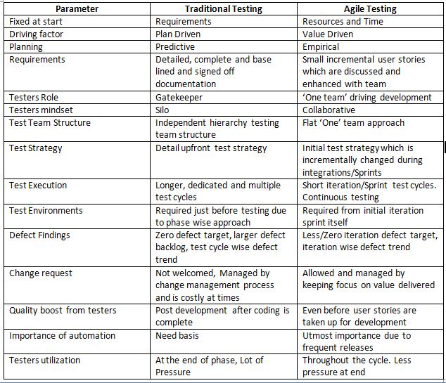
Traditional Testing Vs Agile Testing

Slide 31
Summary
  In this module, you learnt about:
    Software Development Process Models
    The Waterfall model, its usage, advantages and disadvantages
    The V – Model, its usage, advantages and disadvantages
    The Incremental model, its usage, advantages and disadvantages
    The Iterative model, its usage, advantages and disadvantages
    The Agile model, its usage, advantages and disadvantages

